Slide 1
Mini Project
C Program

Slide 2
Restaurant-management-system
Restaurant-management-system is a system made in C language by me which is special than other restaurant management projects because it is generated by token system. If someone orders his dishes but immediately you need to take another order and bill out, this token system then helps you properly. This may give very much interaction to you I believe.

Slide 3
Things I have used
#include<windows.h>– for changing back ground color
If else – for selecting options(conditional statement)
Arrarys – for storing food items
Logical operator – for giving discount
Functions – for running functions

Slide 4
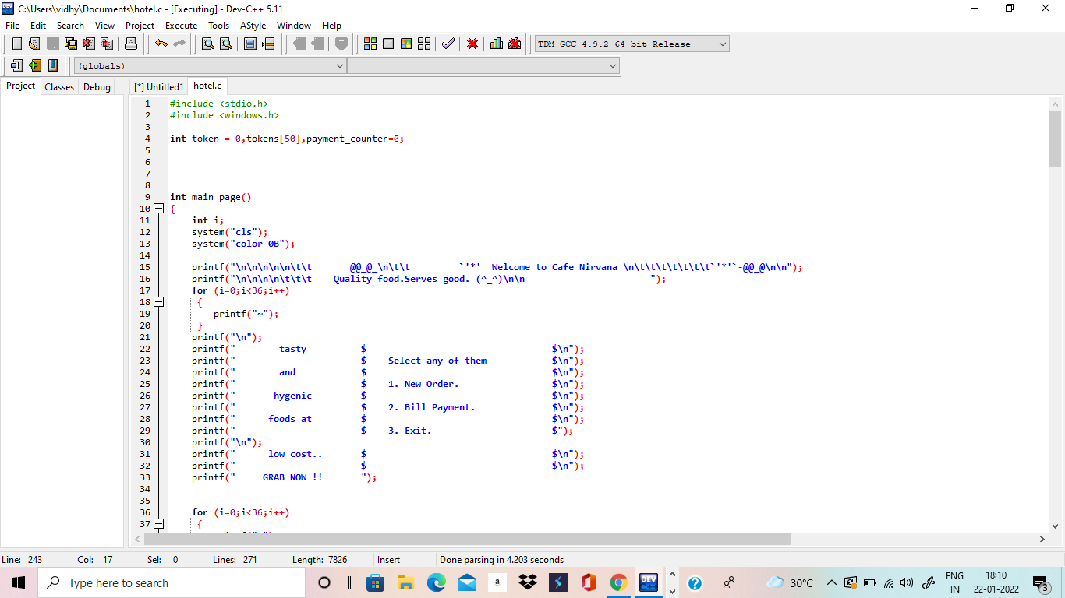

Slide 5
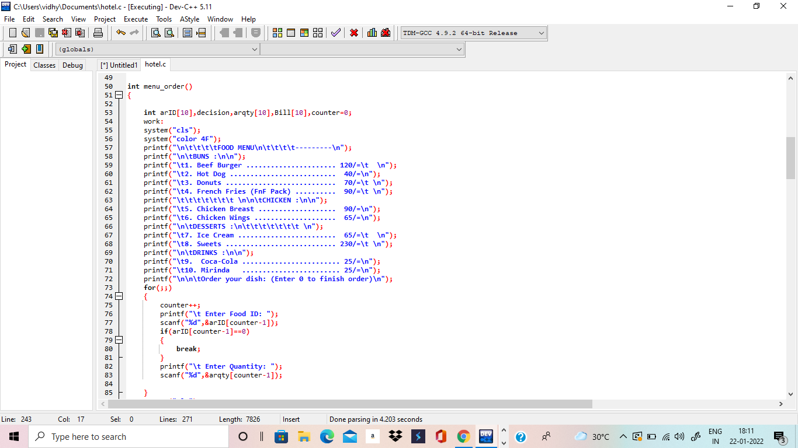

Slide 6
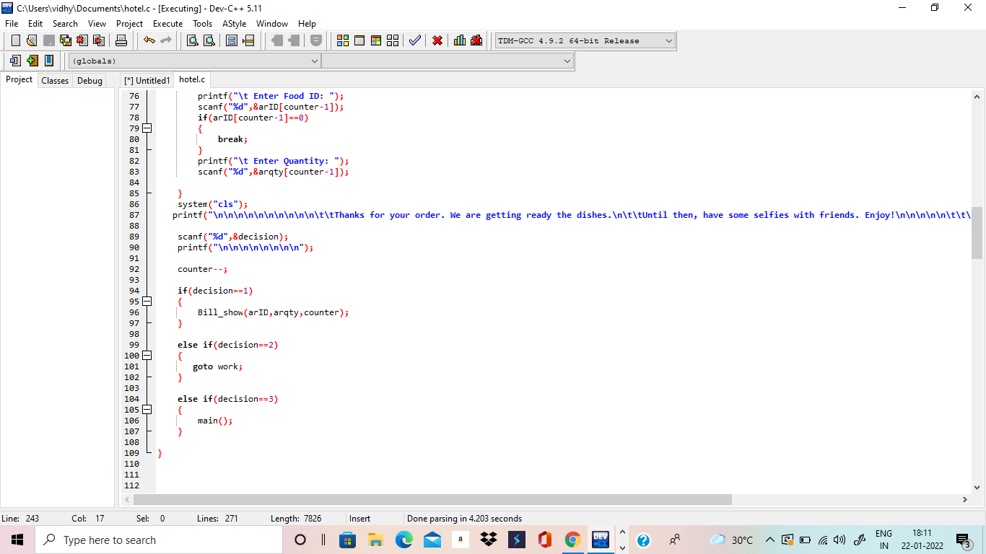

Slide 7
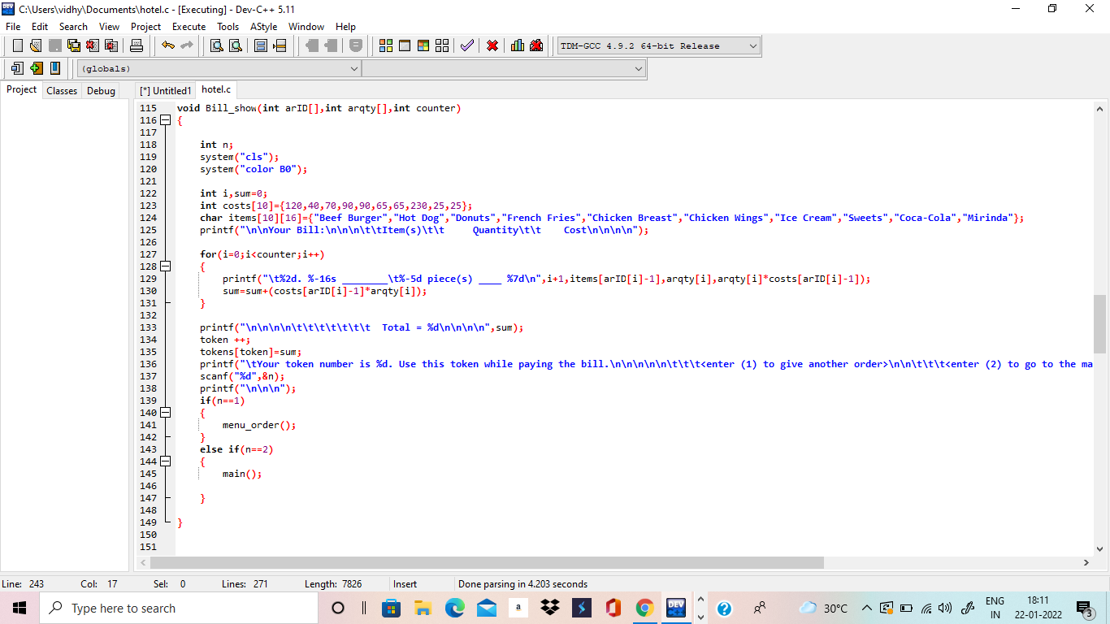

Slide 8
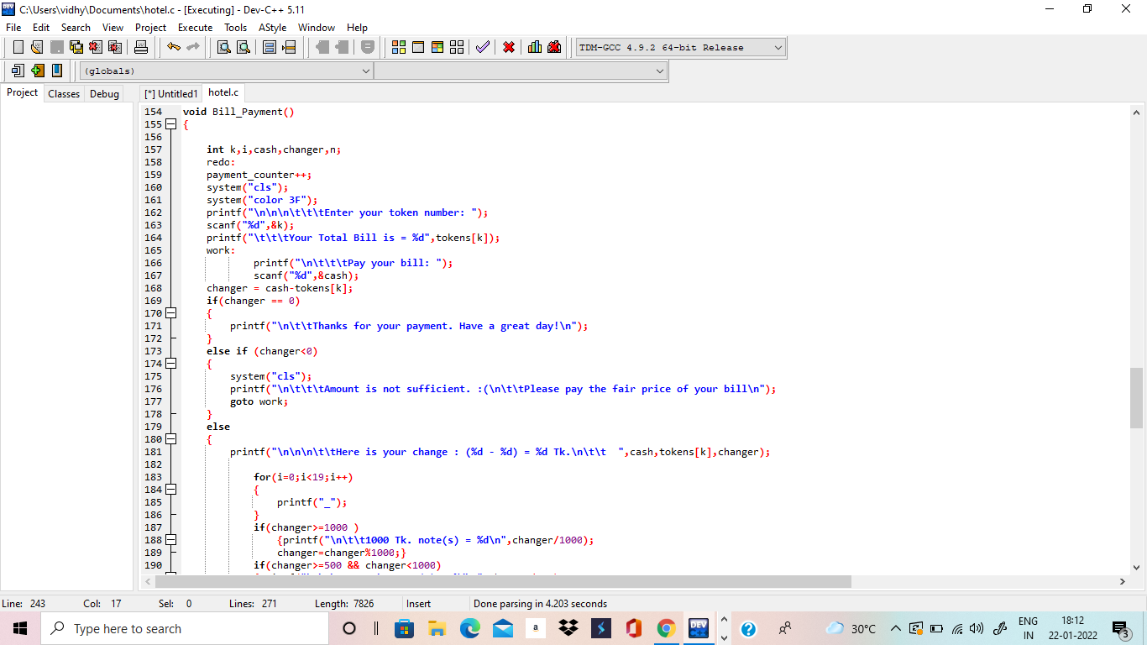

Slide 9
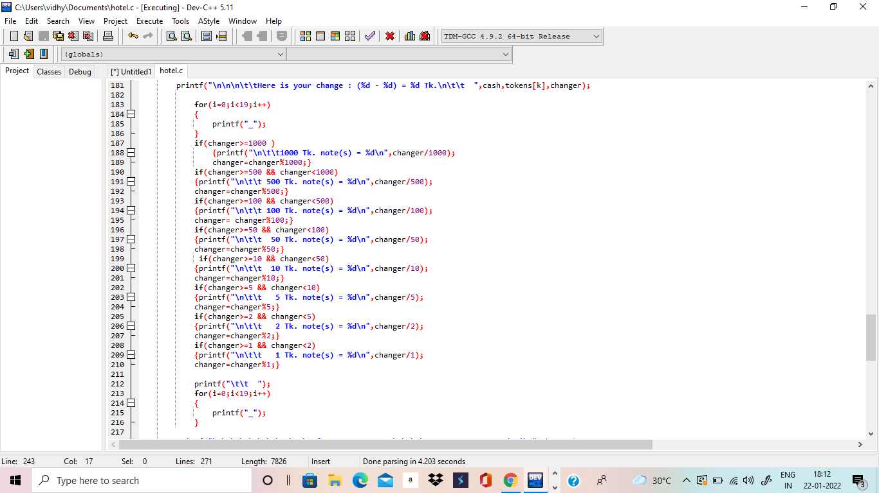

Slide 10
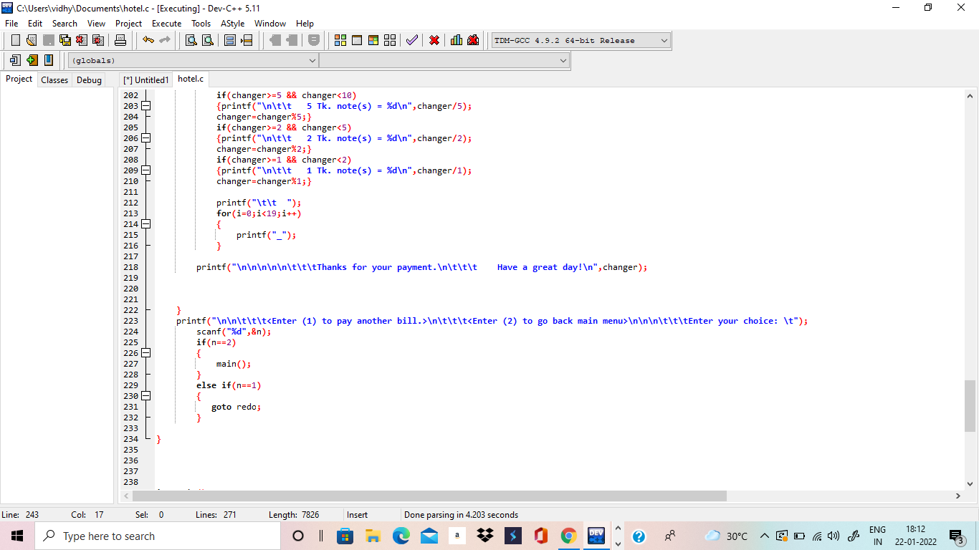

Slide 11
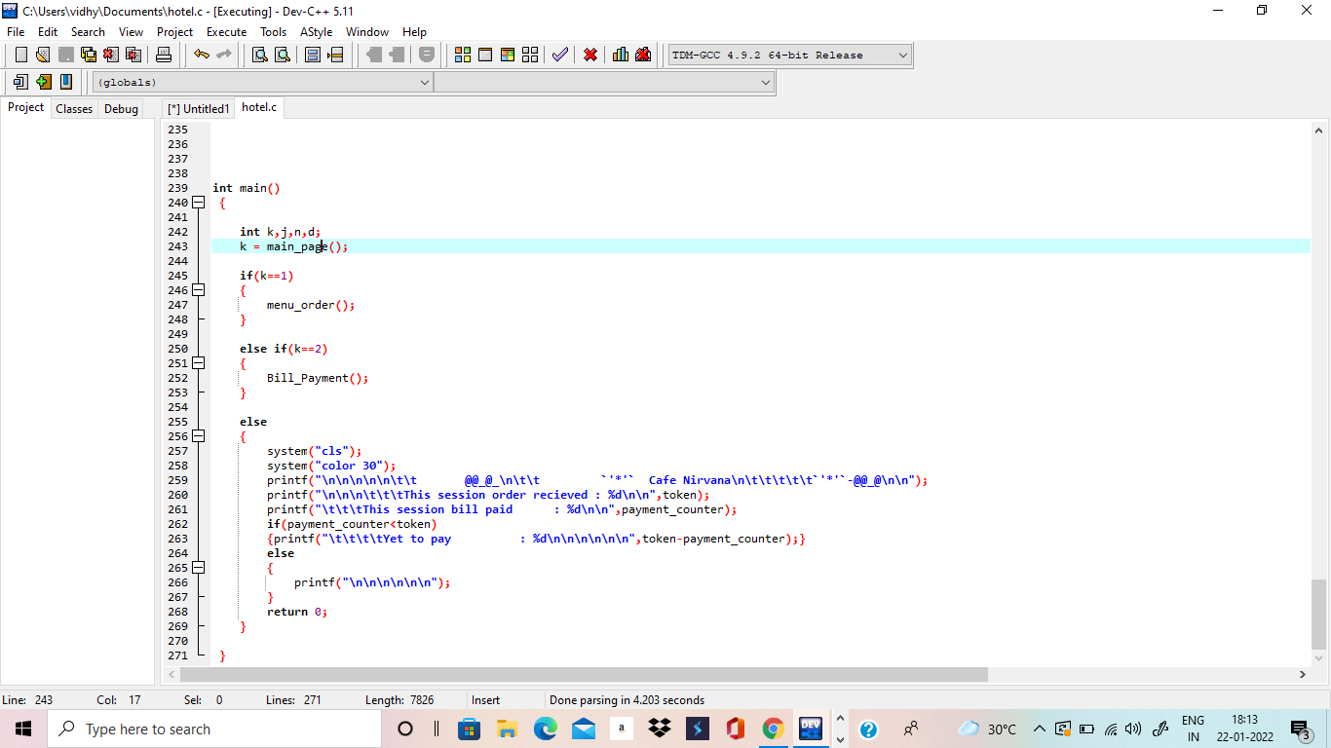

Slide 12
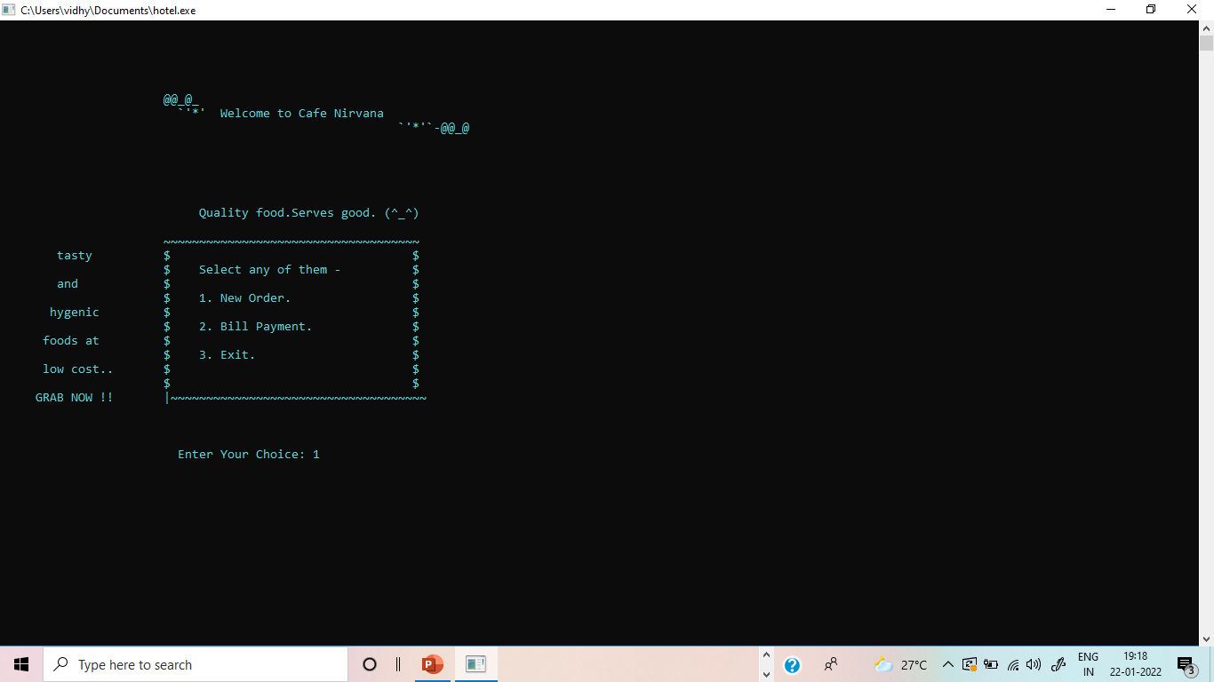

Slide 13
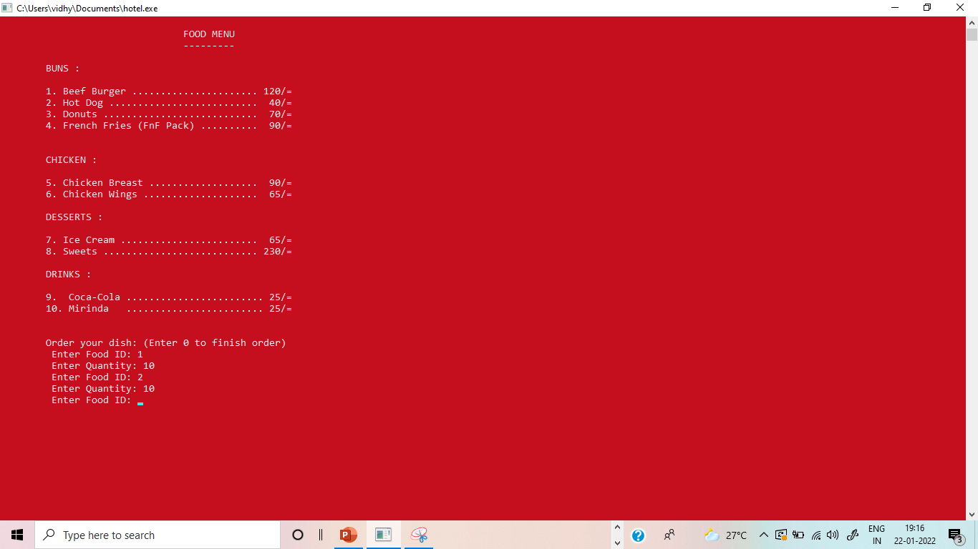

Slide 14
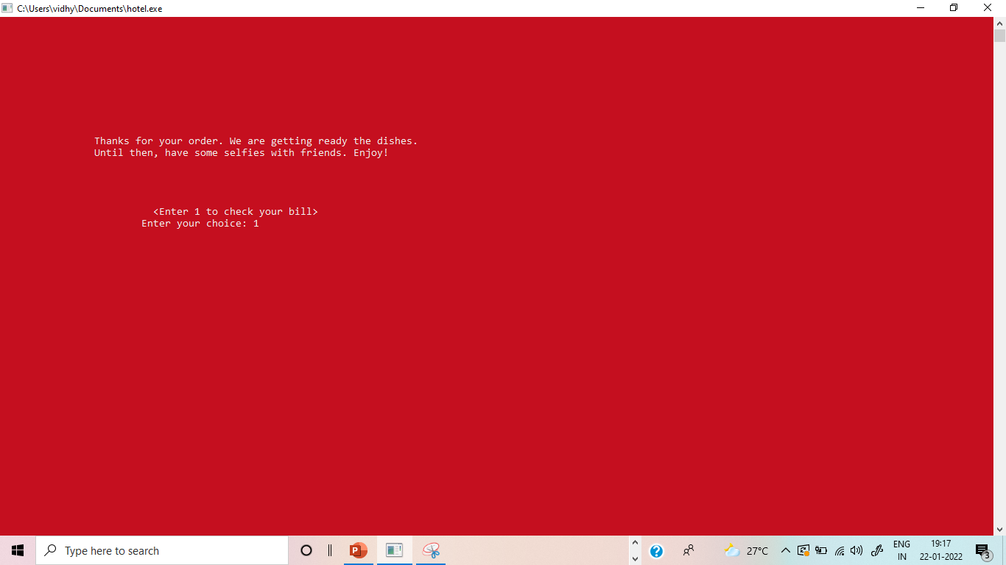

Slide 15
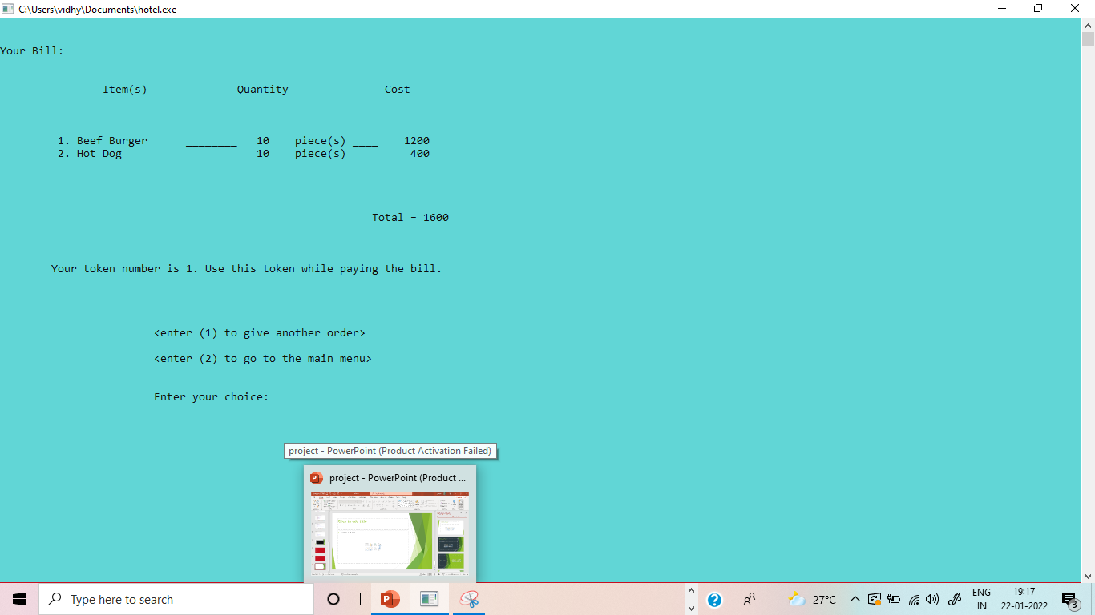

Slide 16
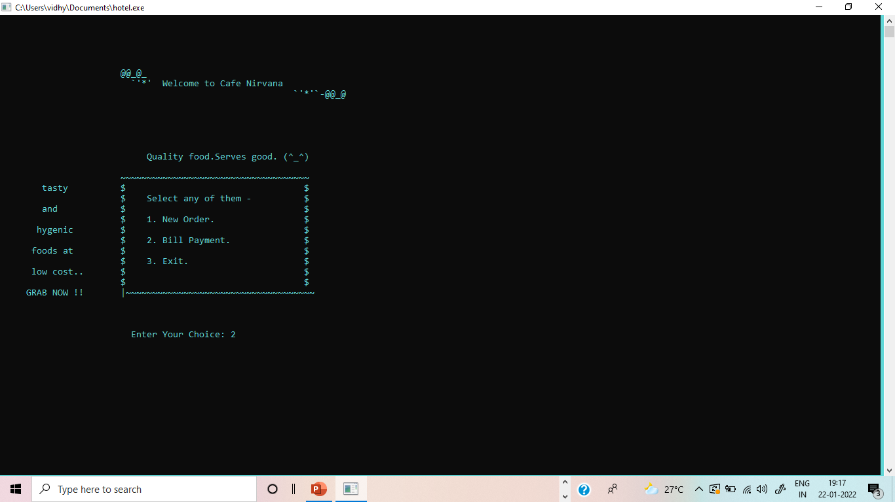

Slide 17
